Slide 1

Bài 14: ORM Basic
Giảng viên: Nguyễn Quang Huy
Email: HuyNQ12@topica.edu.vn
‹#›

Slide 2
ORM?

Slide 3
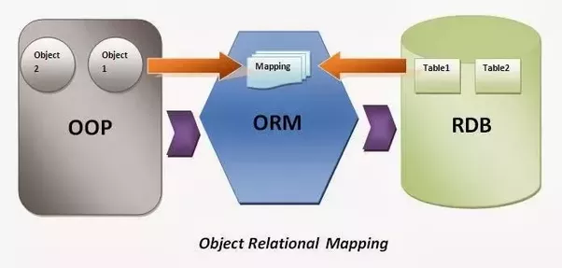
‹#›

Slide 4
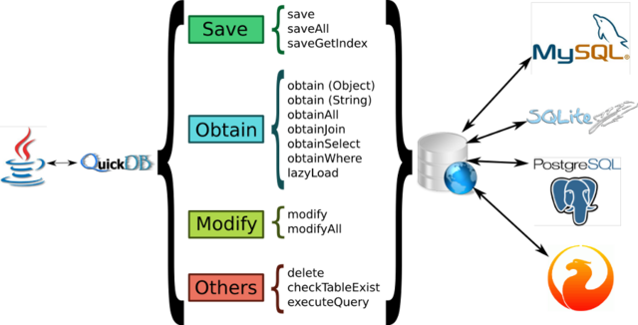
‹#›

Slide 5
ORM framework
Java
Hibernate
Spring Data JPA
.NET
LLBLGen
Entity framework
PHP
Doctrine
Propel
Eloquent
‹#›
Notes:
At the heart are the modules of the core container, including a configuration model and a dependency injection mechanism
While some consider Java EE and Spring to be in competition, Spring is, in fact, complementary to Java EE

Slide 6
Code first vs Database first?

Slide 7
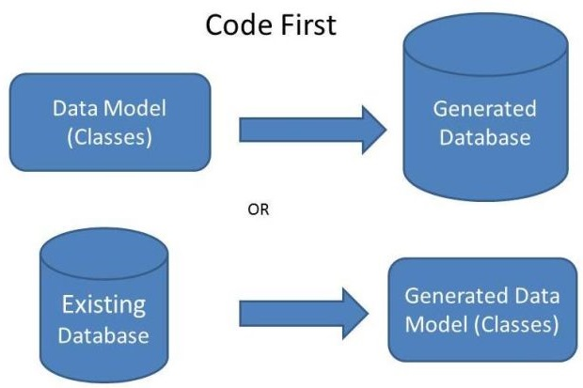
‹#›

Slide 8

‹#›

Slide 9
Connection pooling

Slide 10
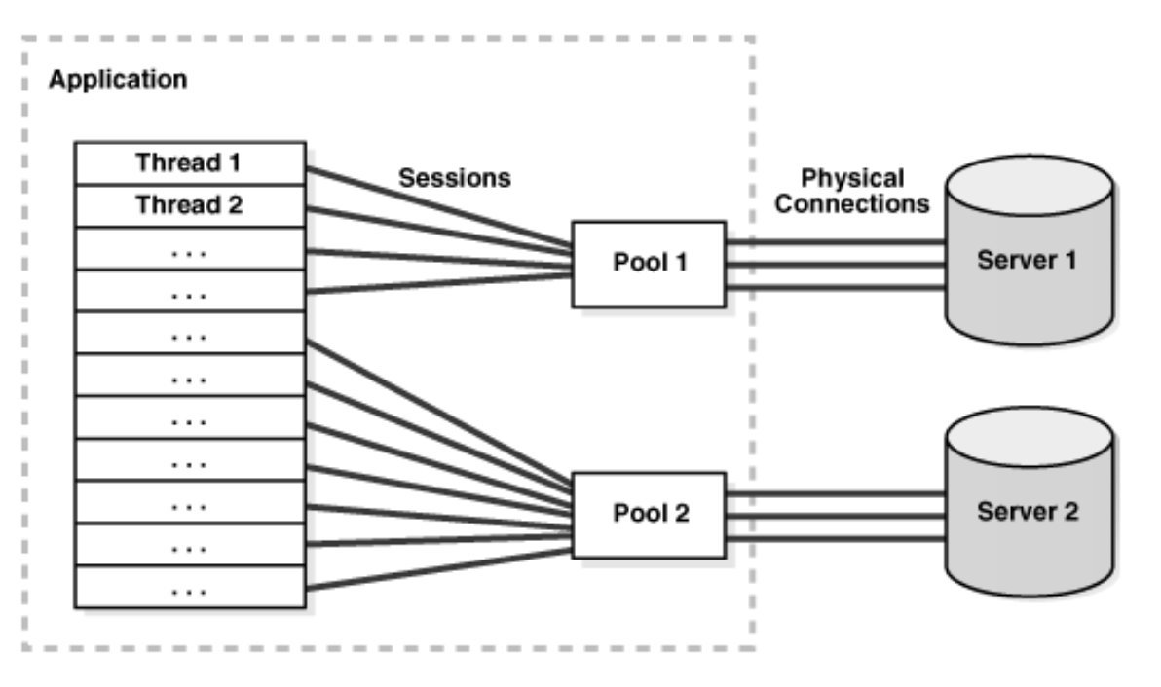
‹#›

Slide 11
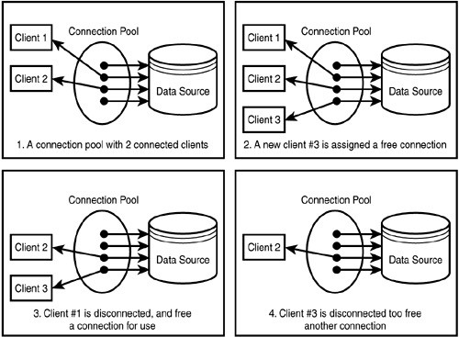
‹#›

Slide 12

‹#›

Slide 13
Task
Build an application use Spring Framework 5.x (Sring boot 2.x)
Business requirements:
Manage: Type (id, name), Category (id, name, typeId), Item (id, name), ItemCategory(itemId, categoryId)
Allow
List<Category> findByType(String type. int pageIndex, int pageSize) - find categories by type name
List<Item> findByCategory(String category. int pageIndex, int pageSize) - find items by category’s name
void updateCategory(Long id, String name)
Technical requirement
Use Spring Data Jpa
‹#›

